Slide 1
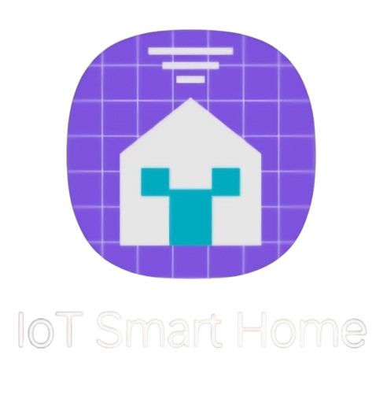

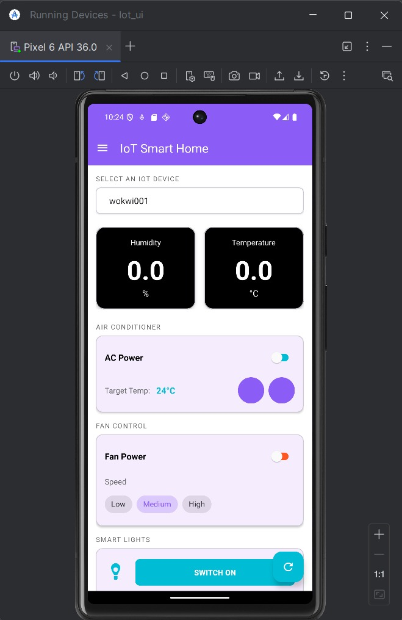
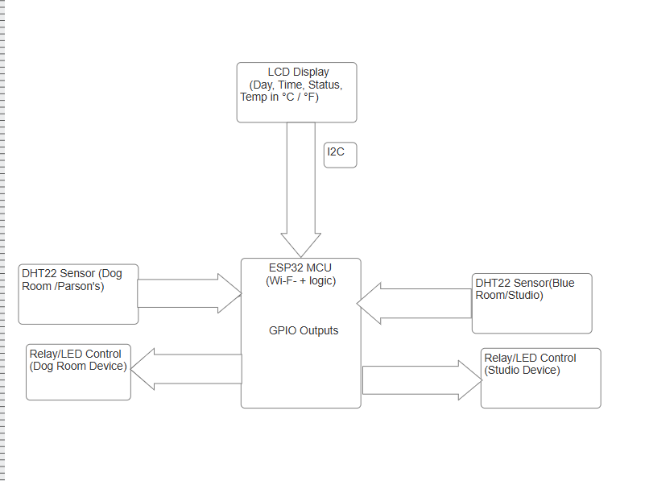
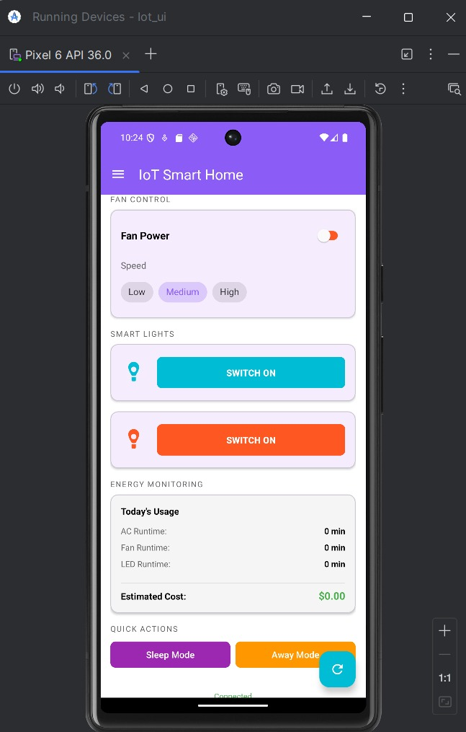
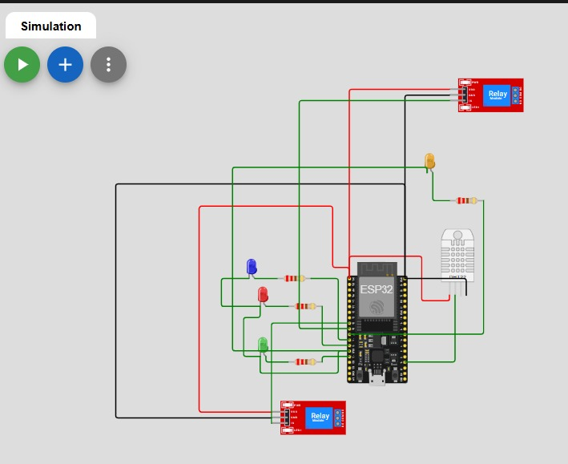
IOT HOUSEHOLD AUTOMATION
Professor- Nima Al-mohmadi
By:-Manav Parikh , Dev Patel , Aryan Prajapati
Motivations
Design Integration
Experiment parameters and results
Background:
Traditional home automation systems require complex wiring and expensive centralized hubs Limited remote monitoring capabilities for temperature and humidity Lack of cost-effective solutions for smart appliance control Security concerns with cloud-dependent systems
Issues caused by traditional systems
High installation costs due to proprietary protocolsDependence on internet connectivity for basic operationsLimited scalability and flexibilityComplex user interfaces requiring technical knowledge
A commonly-used solution:limitations
Commercial smart home systems are expensiveVendor lock-in with proprietary ecosystemsPrivacy concerns with cloud data storageLimited customization options
Motivations:
Develop an affordable, open-source IoT solutionEnable real-time environmental monitoringProvide secure MQTT-based communicationCreate user-friendly mobile control interface
Optimization:
Microcontroller Selection:ESP32 chosen for built-in WiFi and dual-core processingLow power consumption (< 100mA active mode)Cost-effective solution (~$5 per unit)
Prototype
Breadboard implementation with ESP32 DevKitDHT22 sensor and relay module integrationWokwi simulation validated before hardware build
Testing Parameters:
Temperature accuracy: ±0.5°C
Humidity accuracy: ±2% RHWiFi connectivity range: 30+ metersMQTT response time: < 500ms
Relay switching time: < 100ms
Experimental Results:
Temperature Monitoring: Consistent readings within specification
Relay Control: 100% success rate over 1000+ switching cycles
Network Stability: 99.8% uptime over 48-hour test period
Mobile App Response: Average latency of 320ms
Power Consumption: 85mA average (ESP32 + sensors)
Sensor Integration
DHT22 for accurate temperature (±0.5°C) and humidity (±2% RH) monitoring5V relay module for safe appliance switching
Communication Protocol
MQTT ensures lightweight, efficient data transmissionQoS levels guarantee message deliveryHiveMQ broker provides reliable cloud connectivity
Comparison to Traditional Solutions:
45% cost reduction compared to commercial systemsReal-time response (< 500ms) vs delayed cloud processing Local control capability maintains functionality without internet Open-source flexibility allows custom feature additions60% lower power consumption compared to always-on hub systems
Hardware Flow Diagram
UI
Proposed Structure & Analysis
ESP32 Core Module:
Handles sensor data acquisitionManages MQTT communicationControls relay switching logicProcesses mobile app commands
Sensor Subsystem:DHT22 provides environmental data every 2 secondsData validated before transmissionError handling for sensor failures
Relay Control:
Isolated switching for appliance safetySupports loads up to 10A @ 250VACLED indicators for visual status feedback
Communication Flow:
ESP32 reads sensor dataPublishes to MQTT broker (HiveMQ)Android app subscribes to topicsUser commands published back to ESP32Relay states updated accordingly
Simulation
Conclusions
Successfully developed a cost-effective IoT smart home solution Implemented reliable MQTT-based communication architecture Created intuitive Android mobile interface for user control Achieved real-time environmental monitoring with high accuracy

